Slide 1
Mountain grassland dynamics: integrating phenotypic plasticity in a new agent-based model
Ph.D. defence of
Clément Viguier
realised under the supervision of
Björn Reineking
at IRSTEA Grenoble – LESSEM
Uta Berger
Technische Universitat Dresden
Rapporteur
Marie-Laure Navas
Montpellier SUPAGRO
Rapporteur
Annabel Porte
INRA – Université de Bordeaux
Examinatrice
François Munoz
LECA – Université Grenoble Alpes
Examinateur

Slide 2
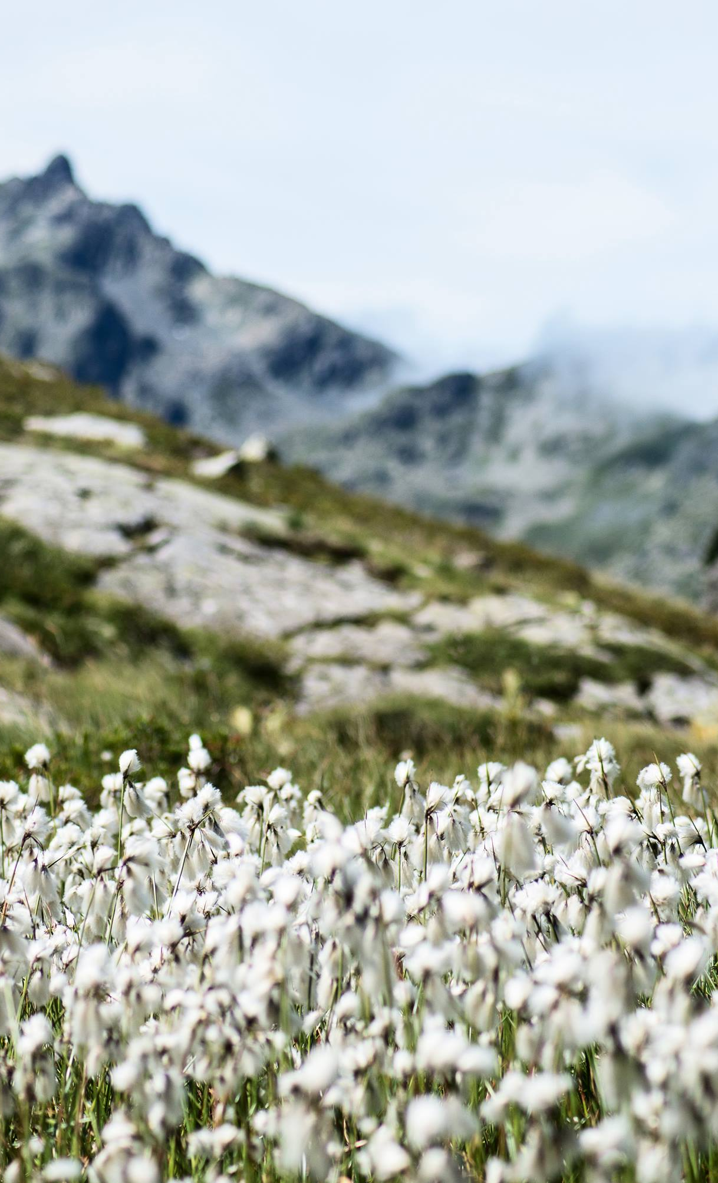
Introduction
1
From context to questions

Slide 3
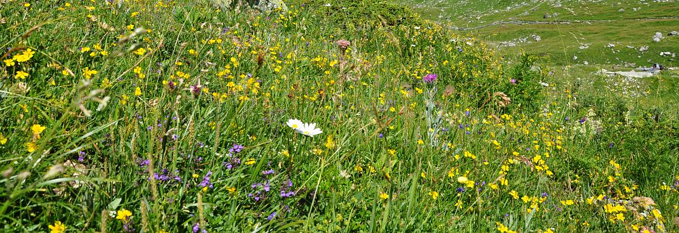
The value of mountain grasslands’ diversity.

Slide 4
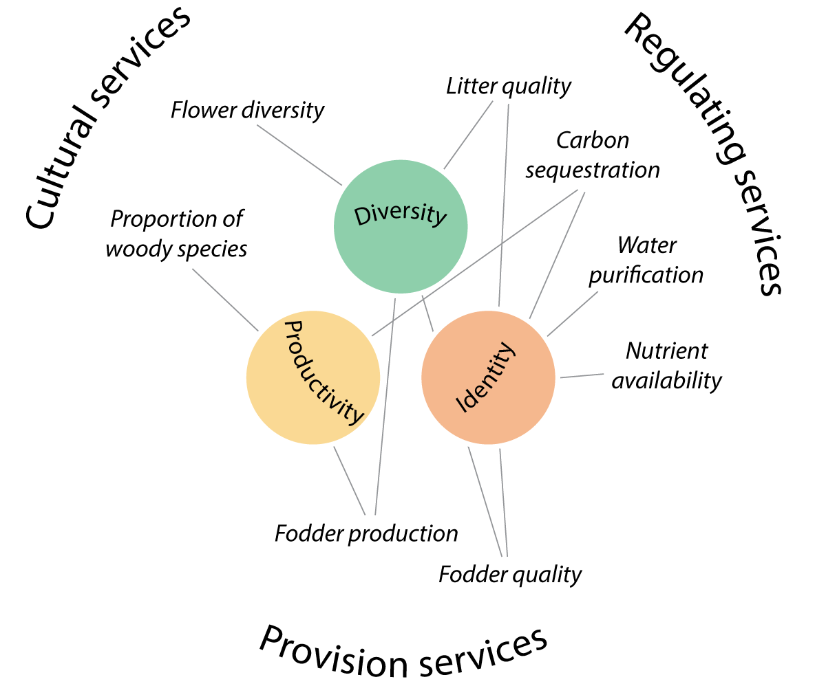
Ecosystem services
Benefits that humans freely gain from the natural environment
Argument for nature conservation
Tool for management

Slide 5
Assessing grassland ecosystem services
Trait: morphological, anatomical, biochemical, physiological or phenological features of individuals or their component organs or tissues - TRY database
Drivers
Description of
community
Summary statistics
Services

Slide 6
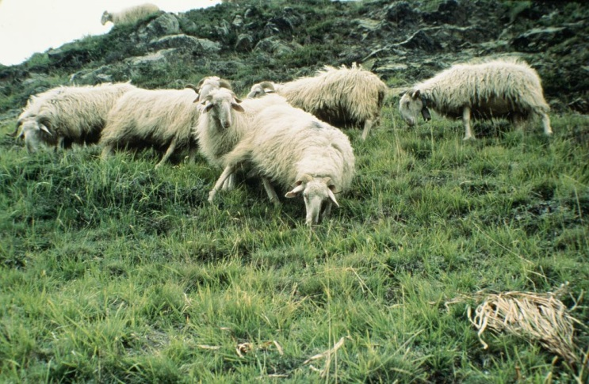
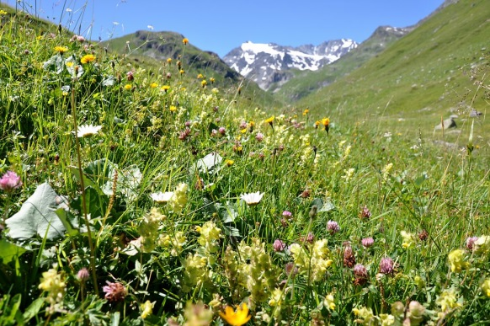
Drivers, global change and services
Summary statistics
Project
Model
Compute
Estimate

Slide 7
Drivers, global change and services
Summary statistics
Project
Model
Compute
Estimate

Slide 8
Intra-specific variability matters and impacts the community responses
Species
turn-over
Should be considered in:
- ES assessments
Dynamic models
ISV
Jung 2014
Up to 40% of the total variability of some traits.
Strong impact on community response

Slide 9
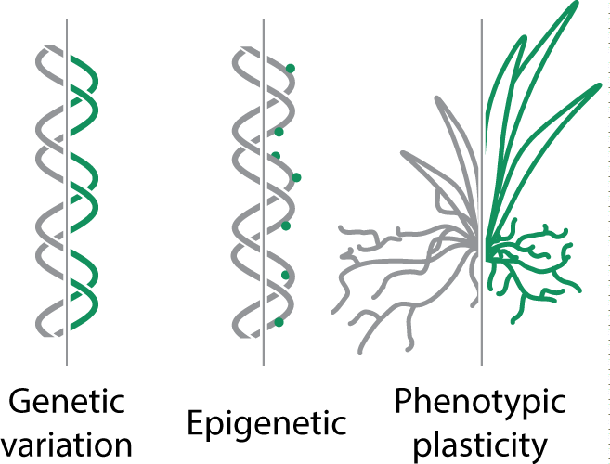
Phenotypic plasticity, one source of variation
Plasticity
Potential for:
- Important role in response to drivers;
- rapid adaptation to global change.
Often overlooked because hard to study in empircal experiment.

Slide 10
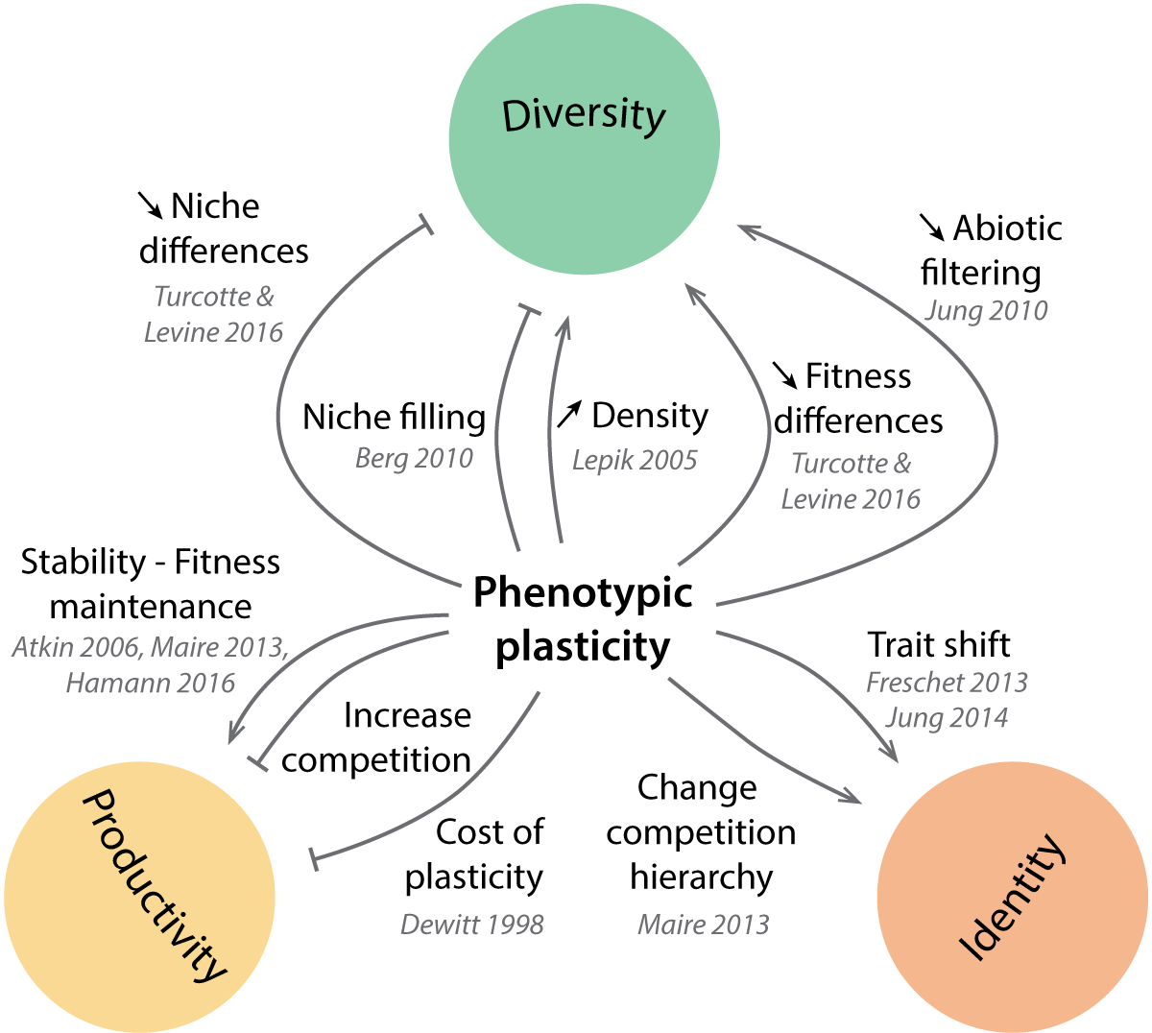
We do not agree, yet
All effects

Slide 11
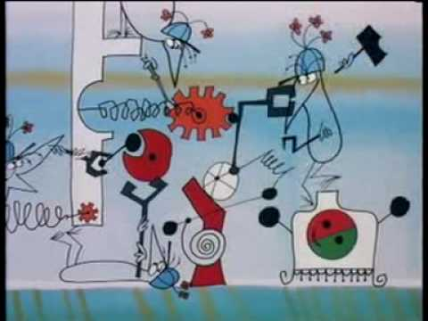
Mechanistic models to understand
More complex, but explicit link with drivers
Understanding by explaining
Emerging behaviour
Experiment at low cost

Slide 12
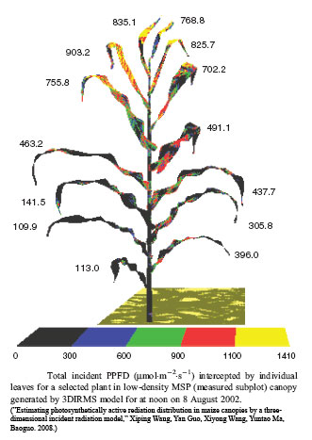
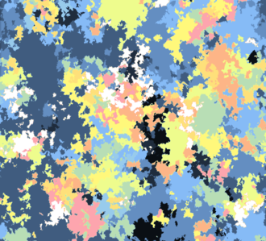
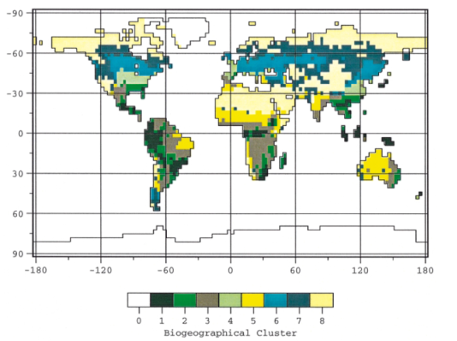
A gap to fill
Combine the species diversity and ecological processes of large scale models with the plant level processes of small scale models.
Molécular
Organ
Individual
Communuty
Landscape
S<
s, min
h, j
j
j, week
mm
cm
cm, m
m, km
Physiological model
Growth/development model
DGVMs

Slide 13
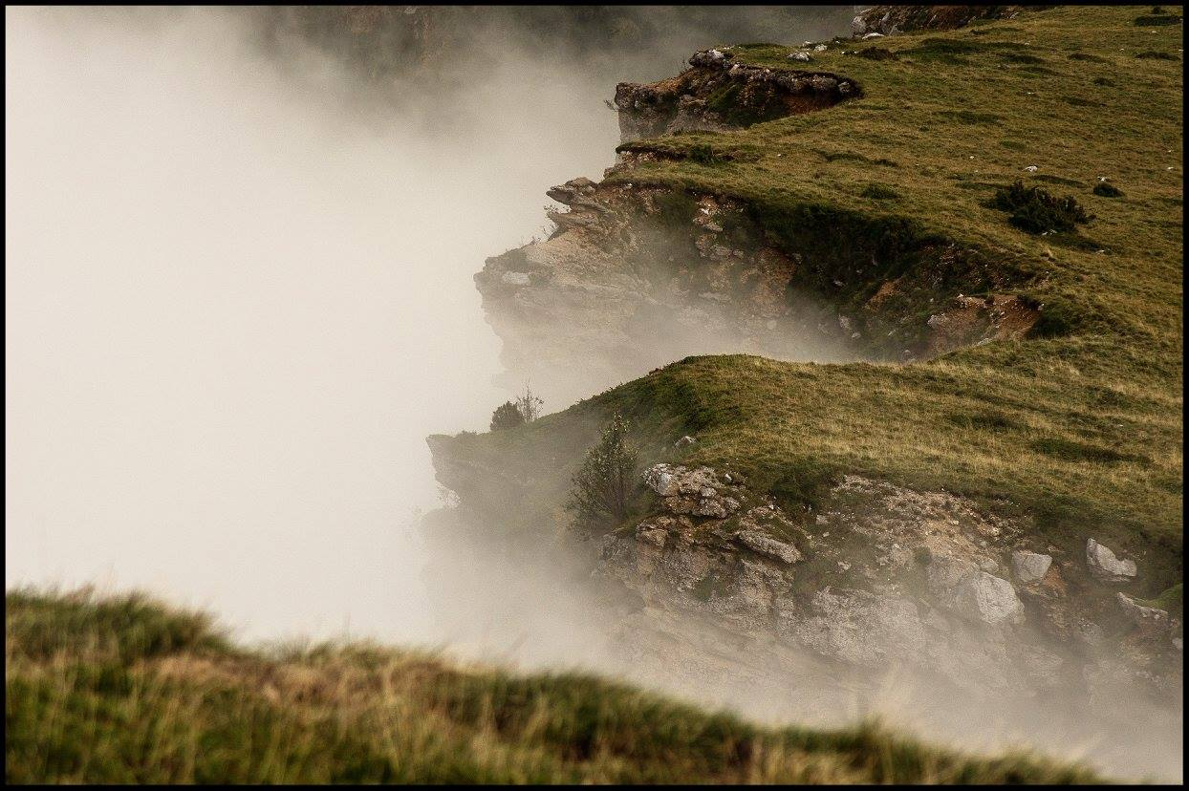
Questions
2
Technical and scientific interrogations

Slide 14
How does phenotypic plasticity impact grassland community properties & dynamics?

Slide 15
How does phenotypic plasticity impact grassland community properties?
How model diverse plant communities integrating phenotypic plasticity?

Slide 16
Concepts
2
From ecological concepts to the model MountGrass

Slide 17
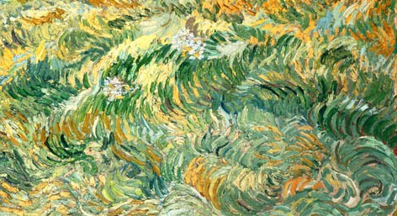
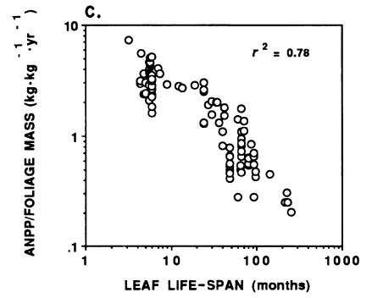
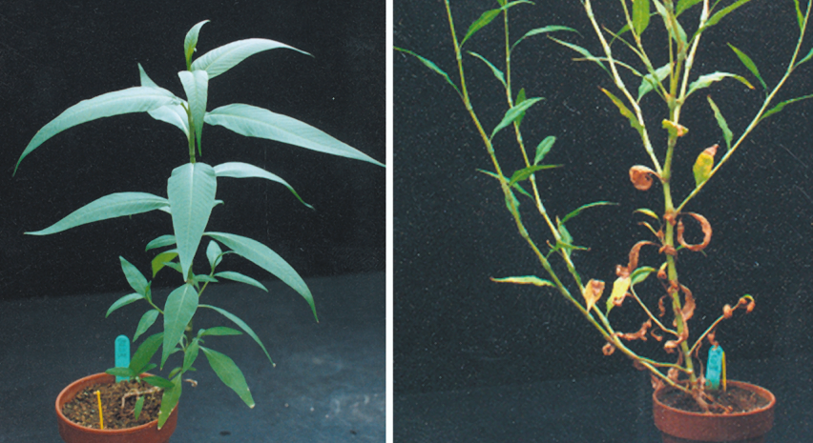
Competition for resources
The Leaf Economic Spectrum
Active phenotypic plasticity
P. Reich (1992)

Slide 18
Competition
Shapes communities by affecting the niche
Is the main plant interaction mechanism
Depends on plant strategies
P. Reich (1992)

Slide 19
Leaf Economic spectrum
Leaf traits are correlated
Dimension reduction of resource-use in leaves strategies to a continum
Depends mainly on the type of tissues the plant invests in
P. Reich (1992)

Slide 20
Active plasticity
Response to environmental cues
Anticipatory and integrated mechanism: often adaptive
Alters morphology and allocation patterns
P. Reich (1992)

Slide 21
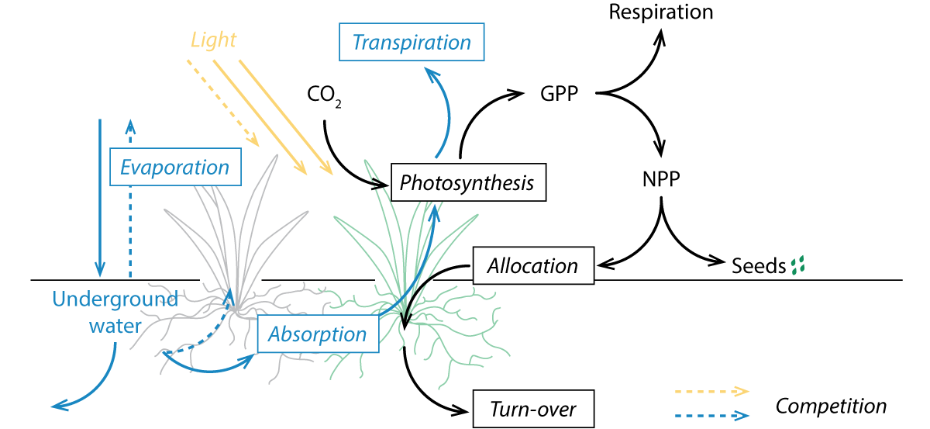
MountGrass’ processes
Response to drivers: physiological processes.
Above and belowground competition: light and water cycles.
Strategies: carbon allocation trade-offs.

Slide 22
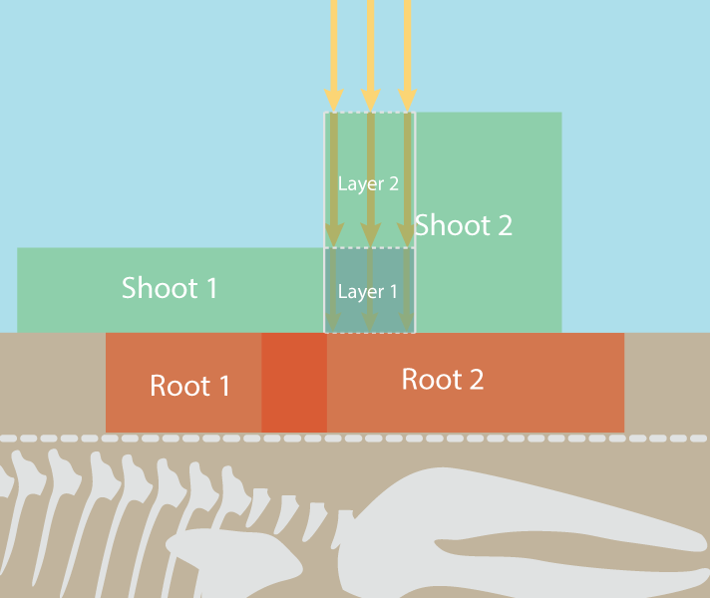
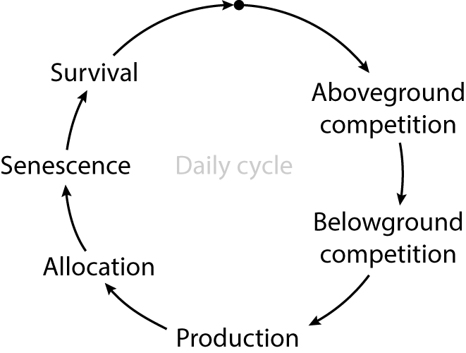
MountGrass’ space and time: individual plant scale
Scale: metter
Resolution: cm
Variability: water content saturation
Individual-based model, spatialy explicit
Scale: season
Resolution: daily cycle
Variability: daily averages (T°, prec., radiations)

Slide 23
Plant carbon pools and allocation trade-offs
6 vegetative pools
3 dimensions:
Root:shoot ratio
Prop. active in shoot
Prop. active in root
Allocation trade-offs
→ strategic trade-offs

Slide 24
Plant carbon pools and allocation trade-offs
6 vegetative pools
3 dimensions:
Root:shoot ratio
Prop. active in shoot
Prop. active in root
Allocation trade-offs
→ strategic trade-offs
Exploitative
Conservatives

Slide 25
Plant carbon pools and allocation trade-offs
ρ_{active} < ρ_{structural}
Strategic trade-offs
=closed strategy space
Generate diversity but with no « super-species »
Exchange rate/biomass
Organ lifespan
Proportion of active tissues in shoot
Exploitative
Conservatives

Slide 26
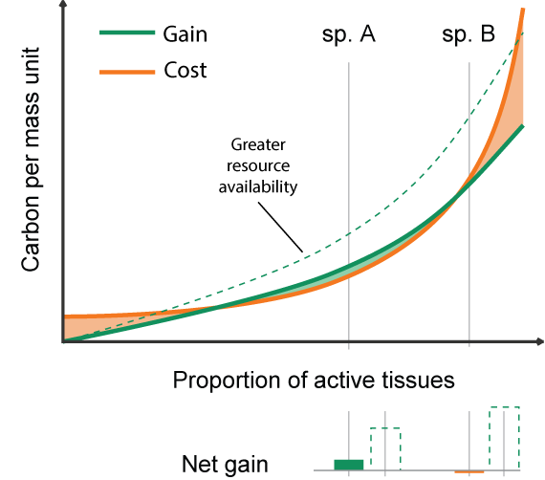
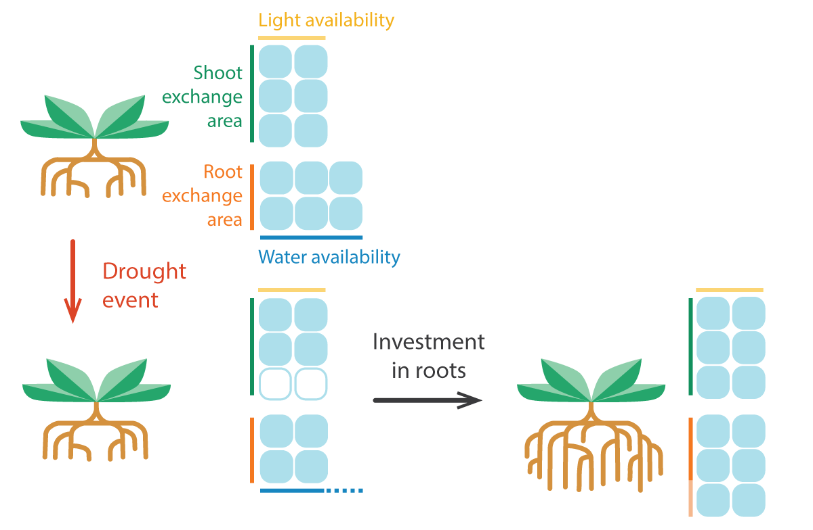
The components of plant growth
Tissue potential efficiency
Balance
Potential
evapotranspiration
Potential root
absorption
How does plasticity fit this representation and drive the phenotype ?

Slide 27
Plasticity: the functional equilibrium
Potential
evapotranspiration
Objective function: root activity = shoot activity
Plastic dimension: Root:shoot ratio
Assumption: tomorrow same as today
Potential root
absorption
« fixed-equilibrium »
= no changes in proportion of active tissues

Slide 28
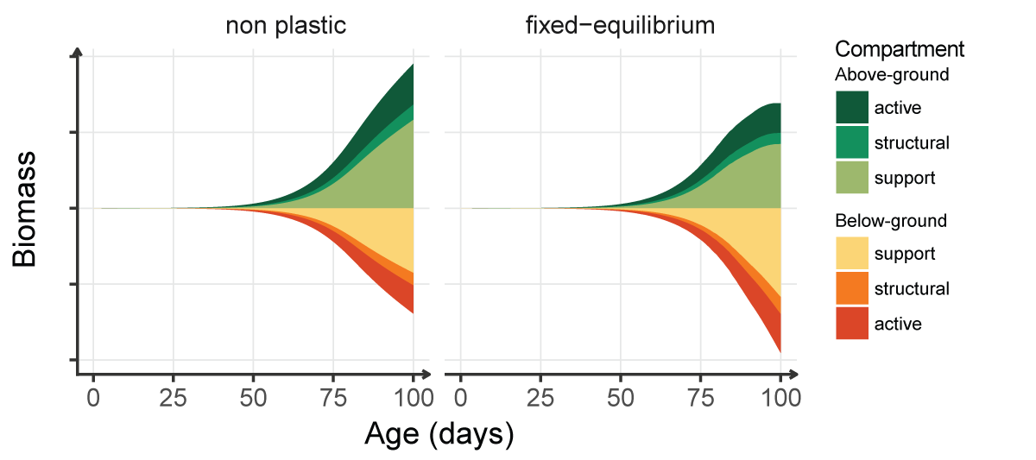
Plasticity in action
Water limiting at the end of the simulation → investment in root tissues
« fixed-equilibrium »
= no changes in proportion of active tissues

Slide 29
Model summary
Allocation trade-off
Close continuous
phenotypic space
Closed continuous
strategy space
Phenotypic plasticity
Species diversity

Slide 30
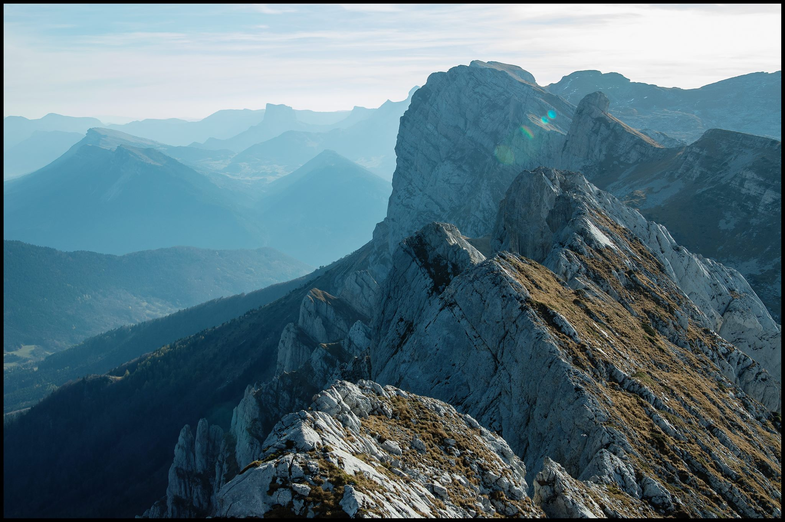
Results
3
Individual- and community-level effects of plasticity

Slide 31
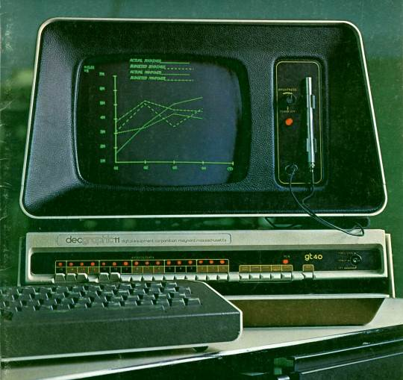
Calibration
26 parameters
5 strategic parameters
Pot growth patterns in 2 treatments of precipitation
→ Selection of a subset of parameter sets for simulations

Slide 32
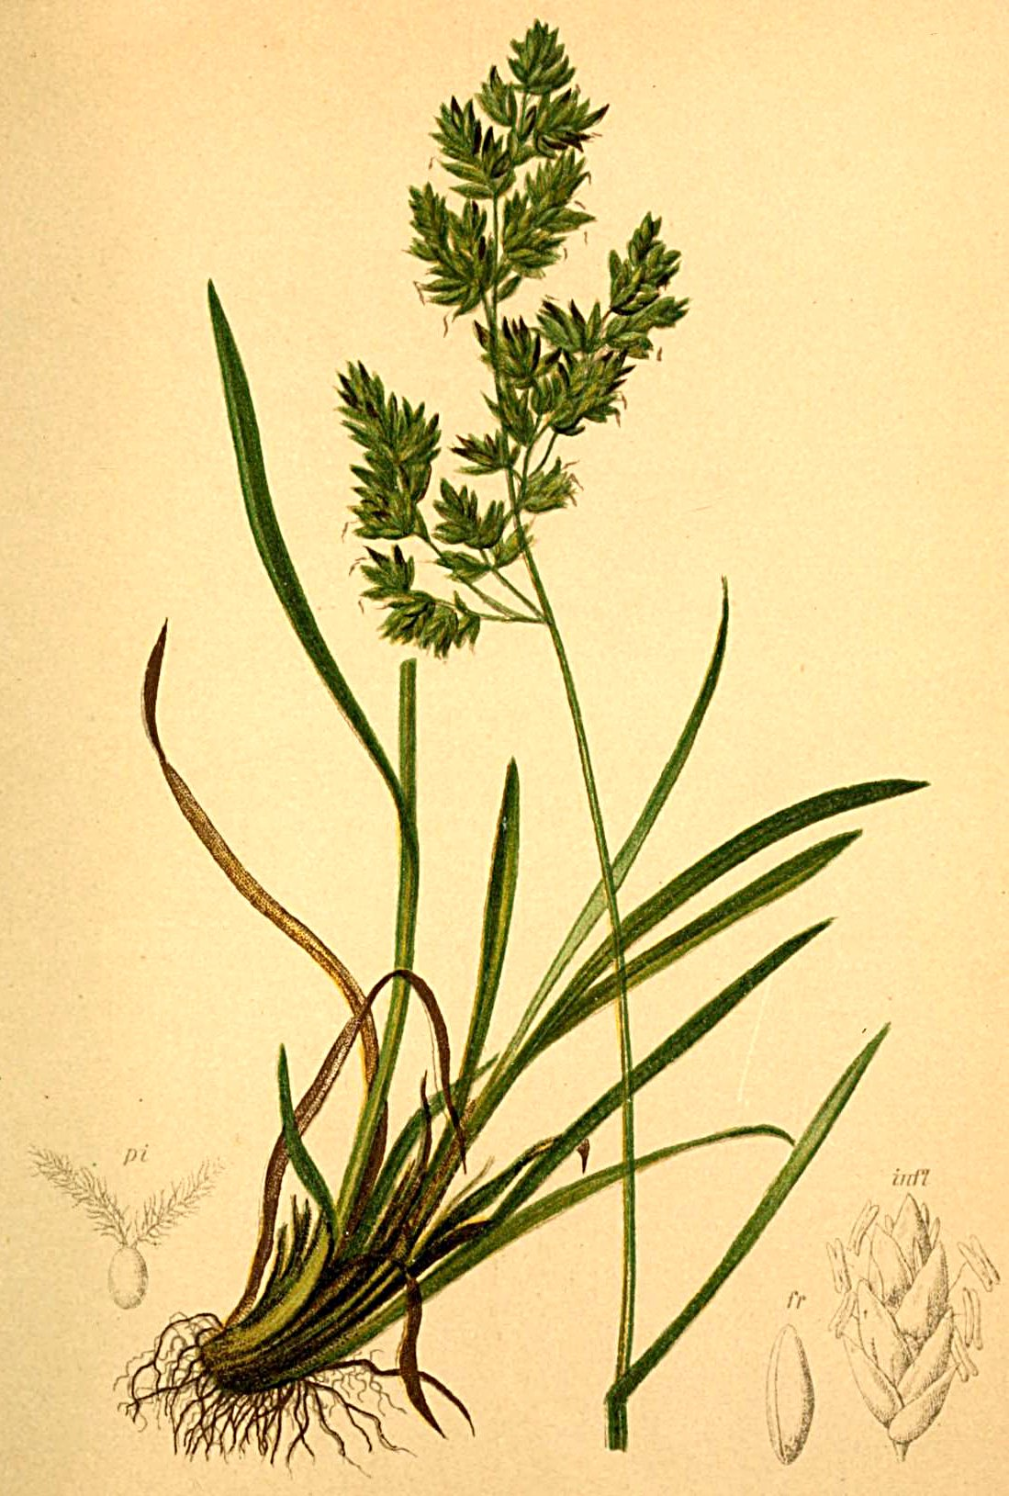
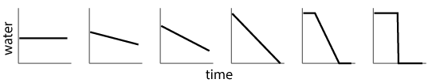
Individual-level simulations
How does plasticity affect individual growth?
with spatial variability: gradient of homogeneous water availability
with temporal variability: gradient of heterogeneous water availability (but same average availability)
→ track biomass for diverse root strategies: maximum biomass, relative performances and dominant strategy
20 parameter sets
12*12*90 cm pots
100 days
fixed T° & irradiance

Slide 33
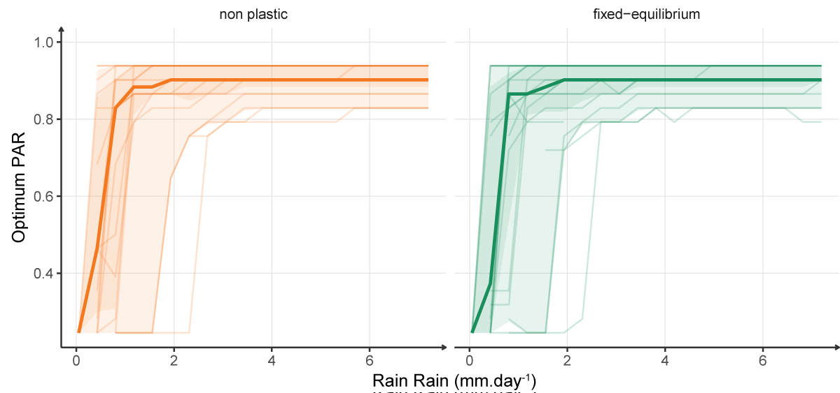
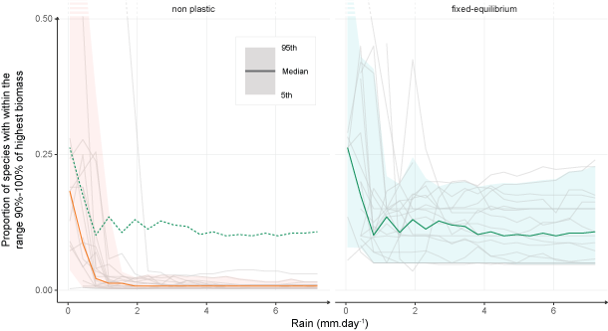
Plasticity effect in homogeneous conditions
No shift in best strategy
Reduction of growth differences
niche widening
no improvment of the dominant species

Slide 34
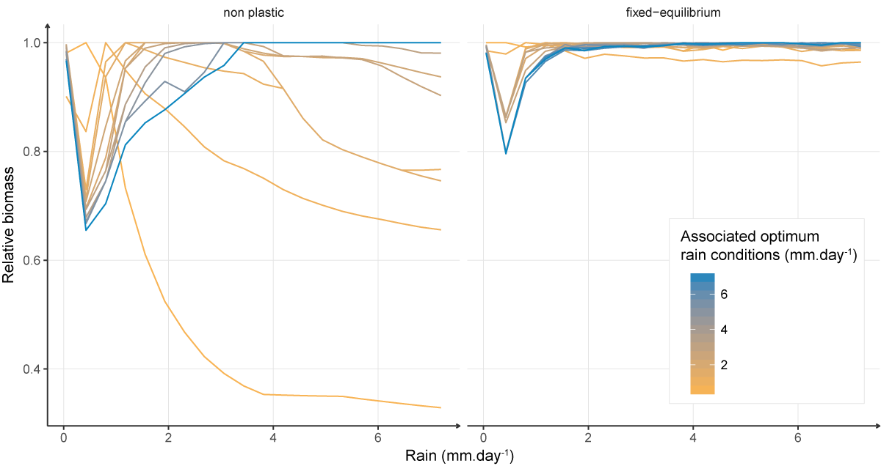
Niche widening in homogeneous conditions
for 1 parameter set
Performance of the best species of each condition
Plasticity → increases relative biomass in non optimum conditions

Slide 35
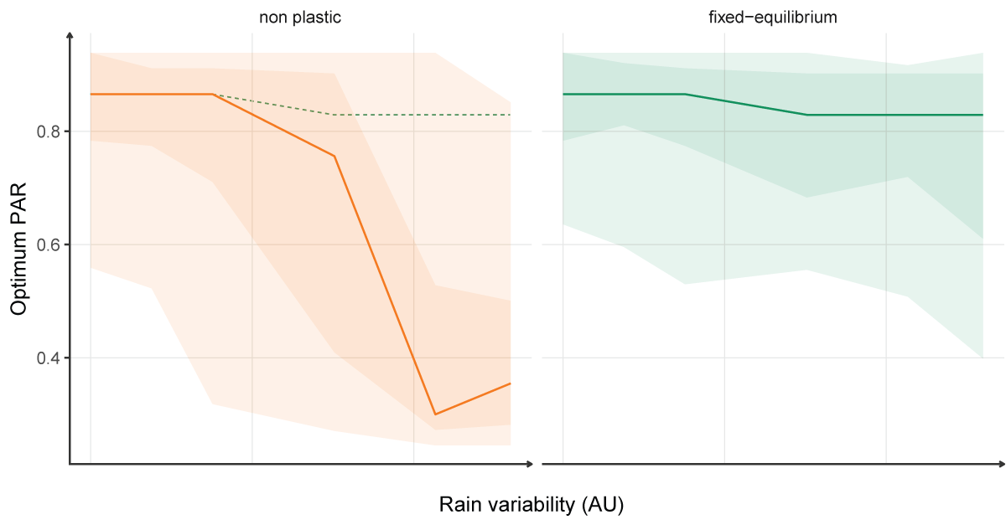
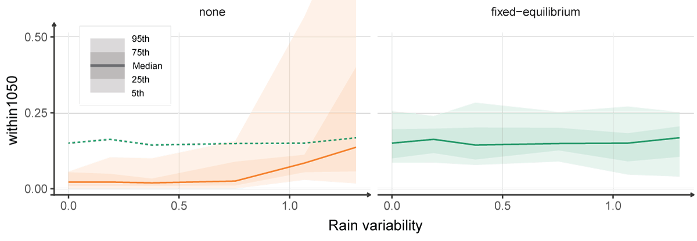
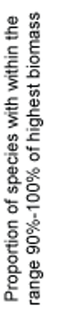
Plasticity effect in heterogeneous conditions
Changes in dominant strategy in favour of dominant species
Reduction of growth differences
Increase of relative BM (not shown)
→ niche widening
assymetric gain (+exploitative strategies)

Slide 36
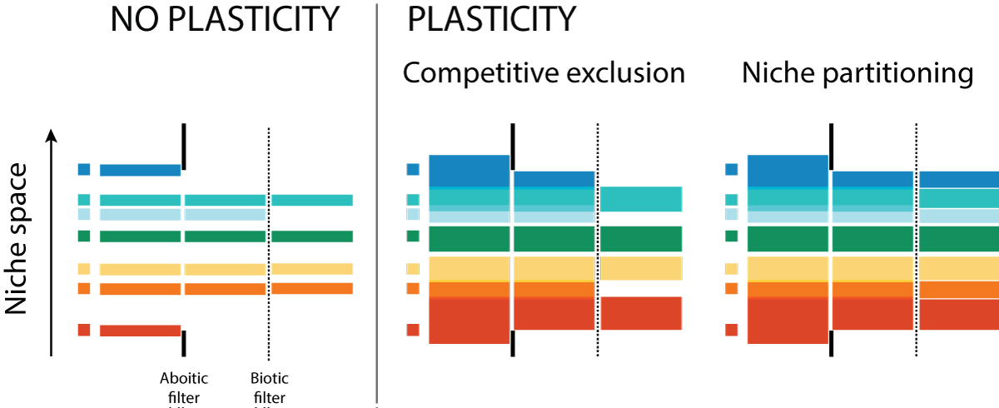
Consequences at the community level ?
Niche widening = reduction of abiotic filtering
higher potential species diversity
Assymetric gain
Competitive exclusion by exploitative species?
Shift in dominant strategy?

Slide 37
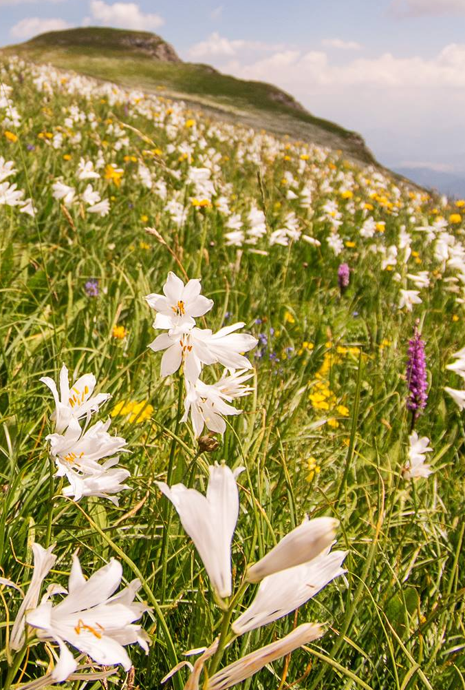
Community-level simulations
How are plasticity effects transfering to community level:
Is competitive exclusion effect larger than the niche widening?
Is there a shift in the dominant strategy?
Long term simulations (300 years)
12 stable parameter sets (reproducing individual after 50 years in non plastic conditions)
400 different phenotypes
Shared seedbank between 6 sites: meta-community
12 parameter sets
100*100cm plots
6 sites:
variable T°, prec. & irradiance

Slide 38
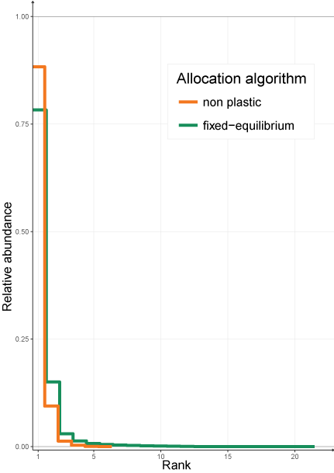
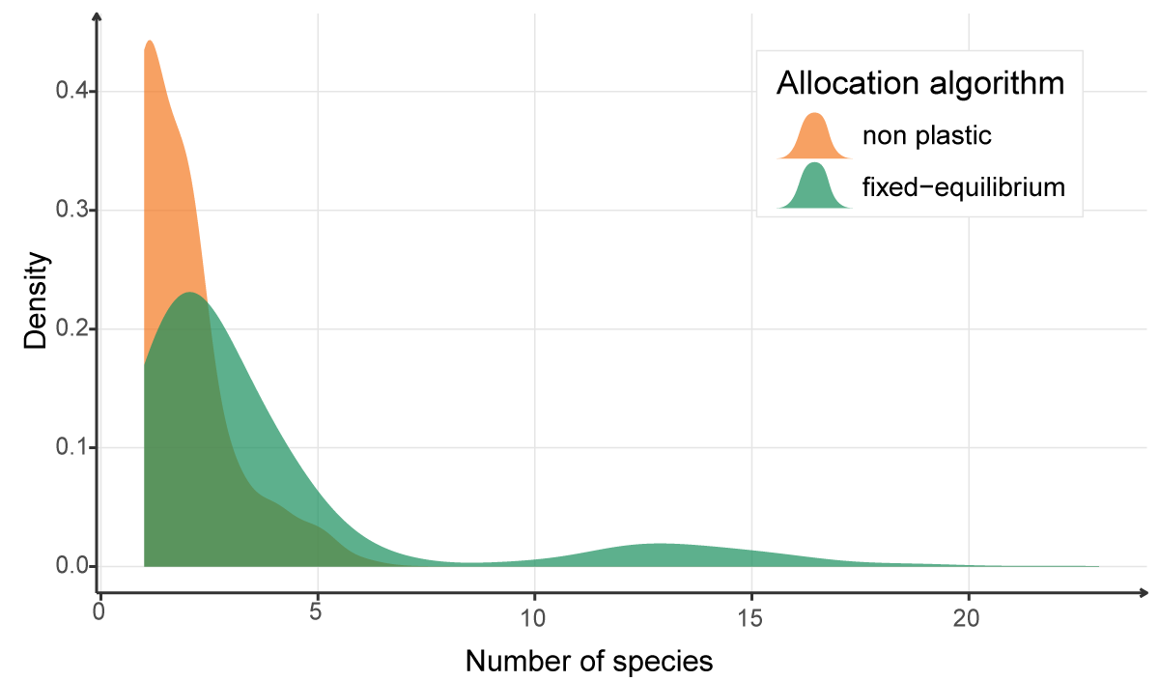
Effects of plasticity on species diversity
Niche widening > competitive exclusion
Effect on dominant strategy (asymmetric gain) ?

Slide 39
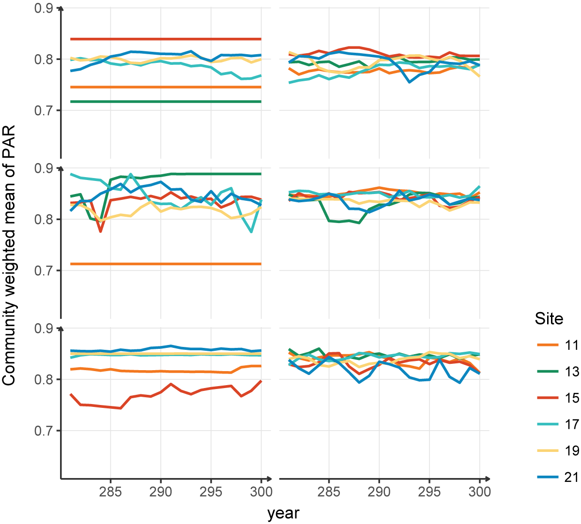
Effects of plasticity on dominant strategy
Non plastic
Fixed-equilibrium
From inter-site variability to inter-season variability
Plasticity reduces functional diversity (meta-community scale)
→ Investigate the structure of the meta-community
1 parameter set
Different meta-community structure

Slide 40
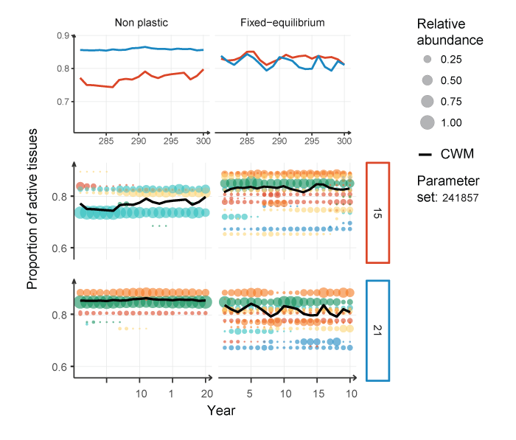
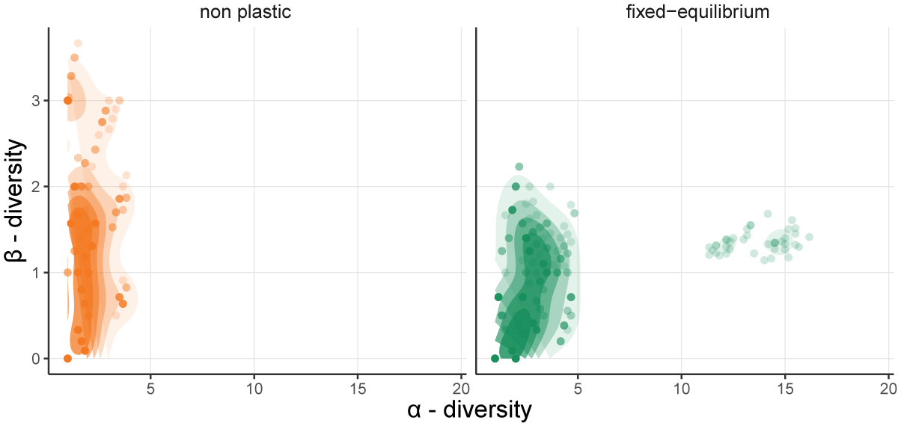
A shift in community structure
From distinct dominated communities to diverse communities with overlap

Slide 41
Results summary
Niche widening
Assymetric gain in favour of exploitative species = loose of sensitivity to climatic conditions
Niche widening > competitive exclusion
Plasticity alters meta-community structure

Slide 42
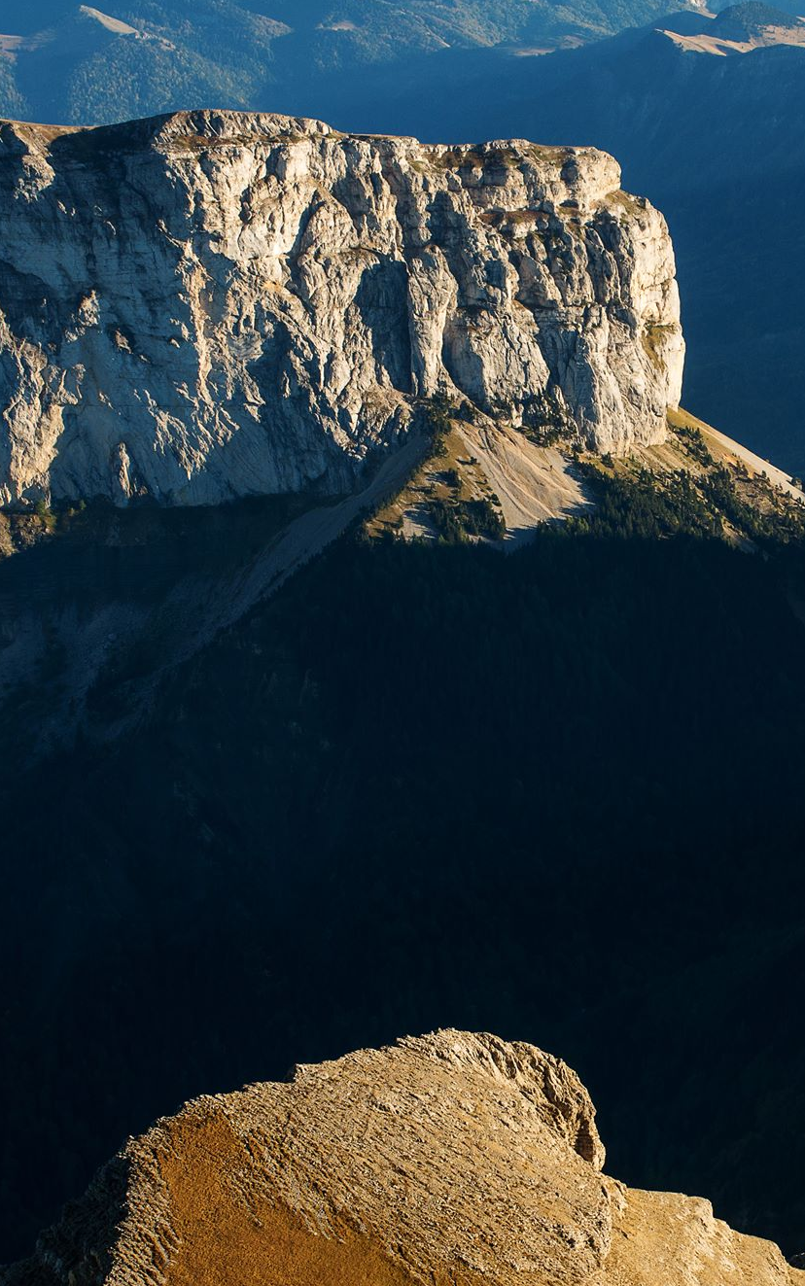
Discussion
4
Impact on community dynamics and community modelling

Slide 43
How plasticity favours exploitative species?
The realised tissue efficiency depends on the overall balance
Conservative species have a greater efficiency but lower rate
Plasticity ensures this balance and negates the sensitivity of exploitative species

Slide 44
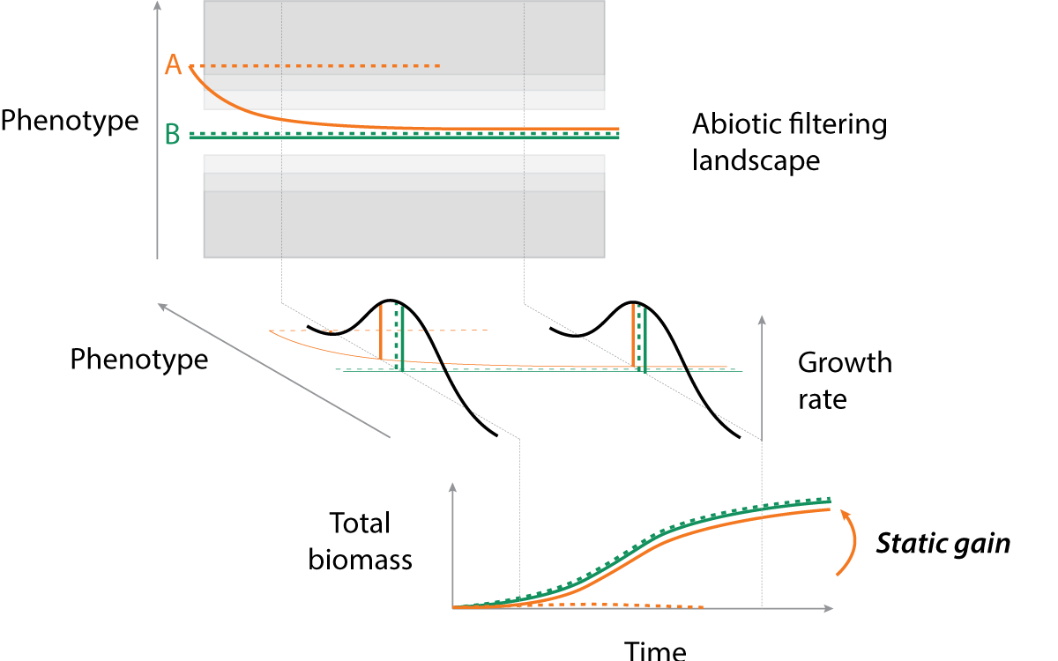
Static gain
Plasticity widen the niche thanks to functional convergence (from 3D to 2D)
Reduced with reduced phenotypic flexibility
Linked to the mechanism of plasticity
: reducing the static gain but not the dynamic gain

Slide 45
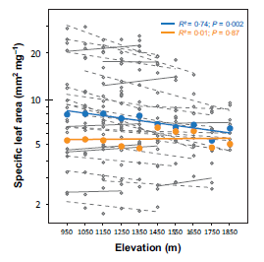
Is there a trade-off between functional and species diversity ?
Does plasticity threaten the functional diversity?
By the reduction of the role of the abiotic filtering:
diversity in other trait is promoted by species diversity
part of the effect is due to strategy sampling
part of it is assymetric gain
By the functional convergence on plastic dimensions:
limited by the cost of plasticity
diversify plastic strategies: avoidance vs resistance

Slide 46
The limits of plasticity
Traits are measures
Plasticity is a shift in what is considered constant (allometry, growth rate, growth traits, plasticity traits → genes?)
Measure of plasticity
Plasticity of plasticity traits
Plasticity = question of complexity of models
How deep should we go in the rabbit hole
Can we extract some general rule, behaviour that goes with the increasing complexity ?

Slide 47
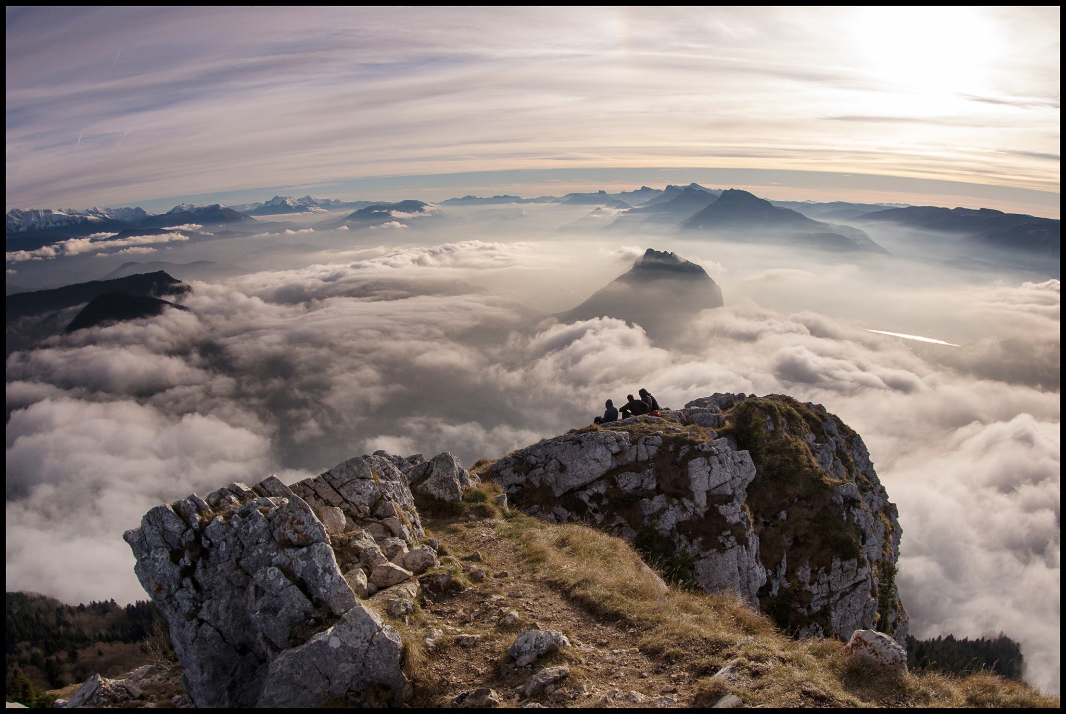
Conclusions & Outlook
5
New hypothesis and simulations
Model developments

Slide 48
Better undertanding of plasticity
Forms of gains: reduction of sensitivity, static gain, dynamic gain (not shown)
Plasticity promotes the species diversity thanks to niche widening
Plasticity may reduce the functional diversity by allowing functional convergence and reducing the abiotic filtering

Slide 49
Better undertanding of plasticity
Forms of gains: reduction of sensitivity, static gain, dynamic gain (not shown)
Plasticity promotes the species diversity thanks to niche widening
Plasticity may reduce the functional diversity by allowing functional convergence and reducing the abiotic filtering
→ Challenge the Gaussian!

Slide 50
Diverse community framework
Diverse strategies thanks to continuous strategies
Resource dependant optimum
Plasticity in coherent framework
Plasticity as a strategy (not explored)
but…
High functional convergence with plastic traits (not shown)
Complex strategy space requiring better sampling

Slide 51
To go beyond
Better calibration and strategy sampling to confirm results
Explore the plasticity as a strategy
Climat, management and perturbation scenarios
New forms of plasticity
+ exploration of other strategy axis (reproduction, frost resistance)
→ Multi-risk plasticity framework
Epigenetics

Slide 52
Thank you

